Slide 1

DMV’s
O primeiro passo para dominar o SQL Server
Dirceu Resende & Jéssica de Lima

Slide 2








Explore your PASS community
Own your career with interactive learning built by community and guided by data experts.
Get involved. Get ahead.
Free online webinar events
Local user groups around the world
Connect with the global data community
.org
Online special interest user groups
Learning on-demand and delivered to you
Get involved

Slide 3


Missed PASS Summit 2019?
Get the Recordings
Download all PASS Summit sessions on Data Management, Analytics, or Architecture for only $399 USD
More options available at PASSstuff.com

Slide 4

We are thrilled to say the first ever PASS Virtual Summit will be taking place this November!
We will be launching PASS Summit into a whole new world, and with that comes exciting opportunities with what we can offer you. We will go beyond simply moving sessions online to fully embracing everything a virtual environment can offer.
Find out more at PASS.org/summit

Slide 5







Thank You to our SQLSaturday BH Sponsors

Slide 6
Free Resources
SQL Server 2019 Free Training aka.ms/sqlworkshops
eBook: SQL Server 2019
aka.ms/sql19_ebook
If you’re eager to learn more tips and best practices, check out these free resources and learning materials.
eBook: Professional Azure SQL DBA
http://aka.ms/sqlsaturday_packt
Handbook: Essential Guide to Data in the Cloud
https://aka.ms/sqlsaturday_essential
Case studies: Future Proof your Data Infrastructure with Azure
https://aka.ms/sqlsaturday_future
Training: Microsoft Learn
https://aka.ms/azuresqlfundamentals
This event was sponsored by Microsoft.

Slide 7
DMV’s – O primeiro passo para dominar o SQL Server

Slide 8
DMV’s e Views de Catálogo
Objetos internos do SGBD
Informações sobre o próprio SGBD utilizando T-SQL
Ideal para automatizações, alertas e monitoramentos
A cada versão, novas DMV’s e views internas são lançadas
DMVs <> View de catálogo

Slide 9
Views de Catálogo
Consultas estáticas a objetos internos em disco/memória
São localizados no schema sys
Views criadas sobre tabelas internas e ocultas do SGBD
Exemplos: sys.databases, sys.tables, sys.objects, sys.configurations, sys.traces, sys.columns

Slide 10
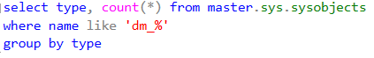
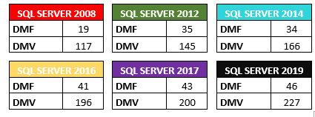
Quantidade de DMV’s e DMF’s

Slide 11
Views/Tabelas de Compatibilidade
Criadas a partir do SQL 2005 para retrocompatibilidade
Não devem ser utilizadas em novos projetos
Podem ser descontinuadas a qualquer momento
Podem resultar em arithmetic overflows em alguns casos
Exemplos: sys.syscolumns, sys.sysindexes, sys.systables

Slide 12
INFORMATION_SCHEMA
Informações de metadata seguindo um padrão ISO
Mesma consulta no SQL Server, MySQL, Postgres, etc..
Existem em cada BD, sob o schema INFORMATION_SCHEMA
Exemplos: TABLES, COLUMNS, ROUTINES, VIEWS, TABLE_PRIVILEGES, TABLE_CONSTRAINTS

Slide 13
Objetos internos da msdb
Informações de metadata do SQL Agent, Database Mail, Service Broker, Backup/Restore, Replicação, Log Shipping..
Exemplos: sysjobs, sysjobactivity, sysjobhistory, backupset, restorehistory, sysmail_mailitems, log_shipping_primaries

Slide 14
DMV’s e DMF’s
Dynamic Management Views e Dynamic Management Functions
Conhecimento fundamental para qualquer DBA
Consultas dinâmicas. Resultado pode mudar a cada execução
São localizadas no schema sys também
Nome dos objetos sempre começa com dm_*
Exemplos: sys.dm_os_wait_stats, sys.dm_db_partition_stats, sys.dm_exec_requests, sys.dm_exec_sessions, sys.dm_db_index_usage_stats

Slide 15
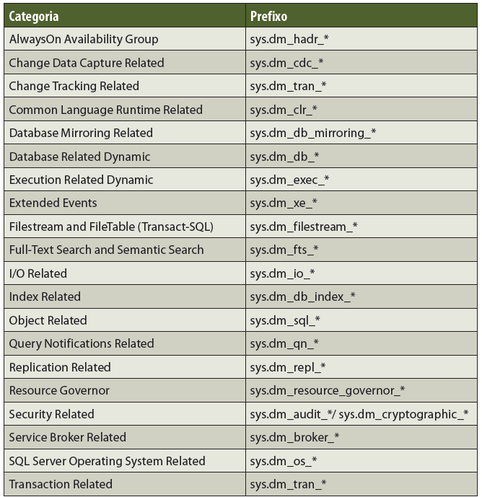
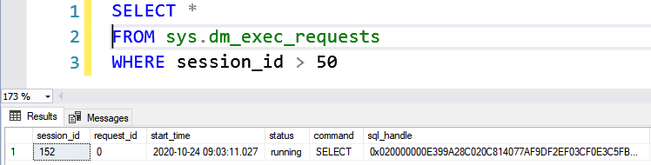
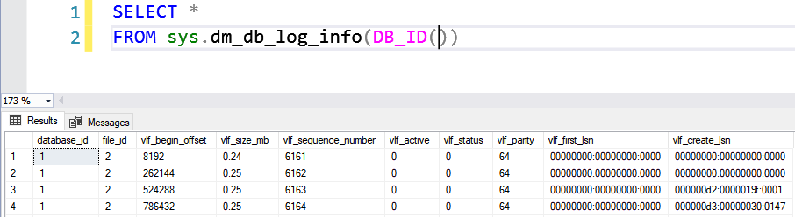
DMV’s e DMF’s
Consulta a uma DMV
Consulta a uma DMF

Slide 16
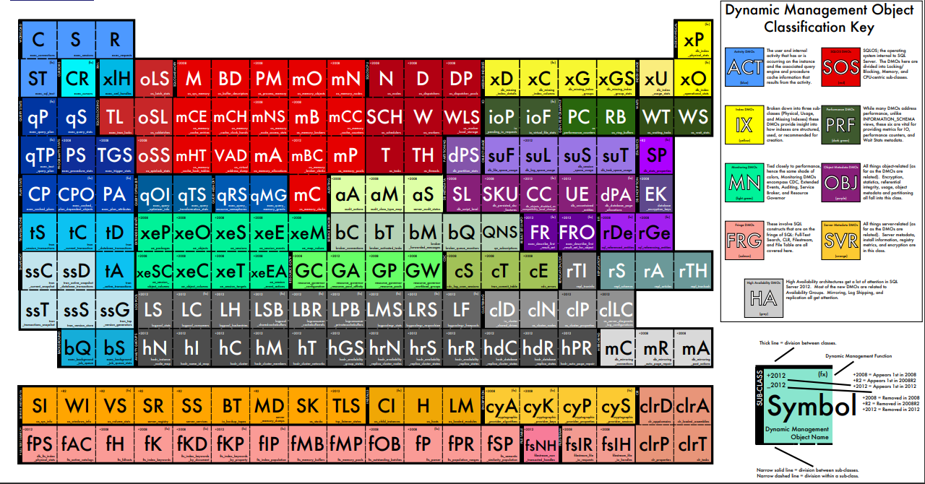
DMV’s e DMF’s

Slide 17
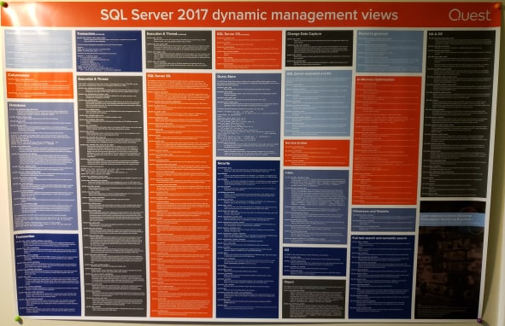
DMV’s e DMF’s

Slide 18
Referências
https://docs.microsoft.com/en-us/sql/relational-databases/system-catalog-views/catalog-views-transact-sql
https://docs.microsoft.com/en-us/sql/relational-databases/system-dynamic-management-views/system-dynamic-management-views
https://docs.microsoft.com/en-us/sql/relational-databases/system-compatibility-views/system-compatibility-views-transact-sql
https://docs.microsoft.com/en-us/sql/relational-databases/system-tables/mapping-system-tables-to-system-views-transact-sql
https://docs.microsoft.com/en-us/sql/relational-databases/system-information-schema-views/system-information-schema-views-transact-sql
https://docs.microsoft.com/en-us/sql/relational-databases/databases/msdb-database
https://www.dirceuresende.com/blog/sql-server-consultas-uteis-do-dia-a-dia-do-dba-que-voce-sempre-tem-que-ficar-procurando-na-internet/

